Slide 1

Revolutionizing Penetration Testing
Caleb Hall, Calla Robison, Michael Allen, Myles Scott, Joshua Buscher

Slide 2
Team Introduction
Joshua Buscher – Documentation Specialist
Calla Robison – Web Developer and Cloud Specialist
Caleb Hall – Scrum Master and AI Developer
Michael Allen – Project Planner and AI Developer
Myles Scott – Web Developer and Documentation

Slide 3
Overview
Main Points
End Goals
Limitations

Slide 4
Mission, Vision and Values
Mission Statement: Empowering Organizations Cybersecurity through cutting-edge Artificial Intelligence
Vision: A Safer Digital World through AI-Driven Security
Core Values: Innovation, Reliability, User-Centric Design

Slide 5
AutoPen's Target Audience & User Accessibility
Target Audience:
Small and Medium Enterprises (SMEs)
Web Developers
IT Security Professionals
User Accessibility:
Ease of Use
Non-Expert Friendly
Training and Resources

Slide 6
Core Offerings of AutoPen
Speed & Efficiency
Cost- Effectiveness
Compliance & Security

Slide 7
AutoPen vs. Traditional Penetration Testing Tools
AI Integration
User-Friendly Interface
Scalability
AutoPen leverages advanced AI for smarter, more efficient testing
Designed for accessibility and ease of use
AutoPen is built to grow with your business

Slide 8
Unveiling AutoPen: Your Cybersecurity Ally
AutoPen – A penetration testing tool Automated for efficiency, Adaptive to the evolving threats, Comprehensive in security assurance.
Key Features
Automated - AutoPen employs cutting-edge AI to conduct thorough security audits without the need for constant human oversight.
Adaptive - The system's adaptive algorithms ensure that it learns and improves from each test, staying updated with the latest cybersecurity challenges.
Comprehensive - Unlike basic penetration tests, AutoPen provides a full-spectrum analysis, leaving no stone unturned in your digital environment.

Slide 9
The Catalyst for Innovation: Overcoming Manual Penetration Testing Limitations
AutoPen represents a paradigm shift from traditional methods, introducing automation, consistency, and in-depth penetration testing.
AI's predictive power and adaptability make AutoPen a proactive tool in a landscape where reactive strategies fall short.
By automating the testing process, AutoPen liberates resources, allowing organizations to focus on compounding strategic security initiatives.

Slide 10
Specializing in Web Application Security
Scope:
Web Application Penetration Testing
AutoPen specializes in identifying vulnerabilities in web applications
Comprehensive Coverage
From front-end user interfaces to back-end databases AutoPen
Real-World Attack Simulations
AutoPen simulates a variety of attack scenarios

Slide 11
The Inner Workings of AutoPen
Step-by-Step Process:
User Registration
Setting Up a Test
Test Execution
Data Analysis
Result Presentation
Backend Mechanics:
AI Algorithms:
Cloud-Based Operations
Continuous Updates
Data Analysis
The step-by-step process outlines a user-friendly approach to conducting thorough web application penetration tests.
Backend mechanics emphasize the sophisticated technology driving AutoPen, highlighting AI and cloud-based capabilities.

Slide 12
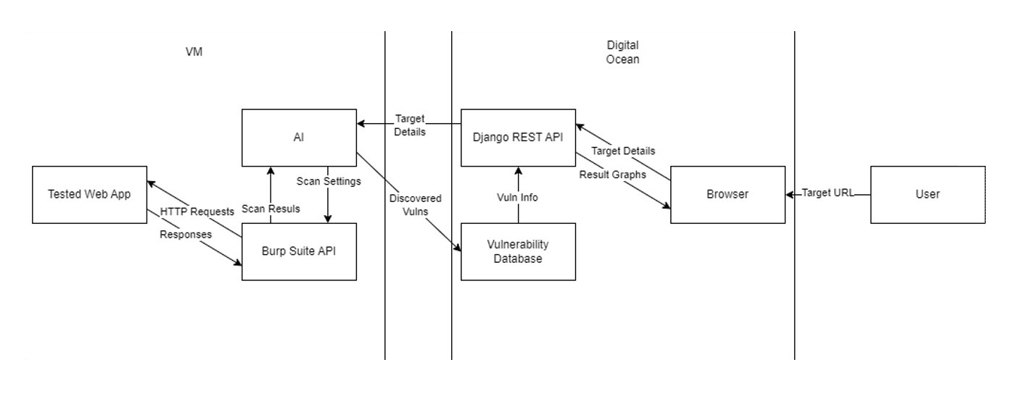
Implementation

Slide 13
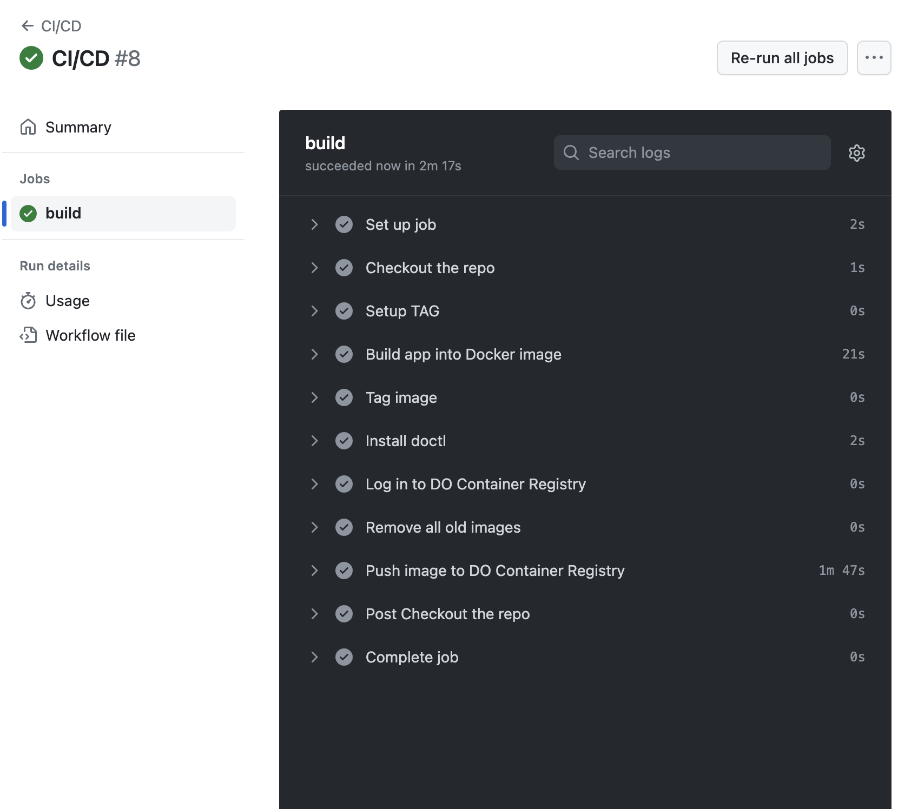
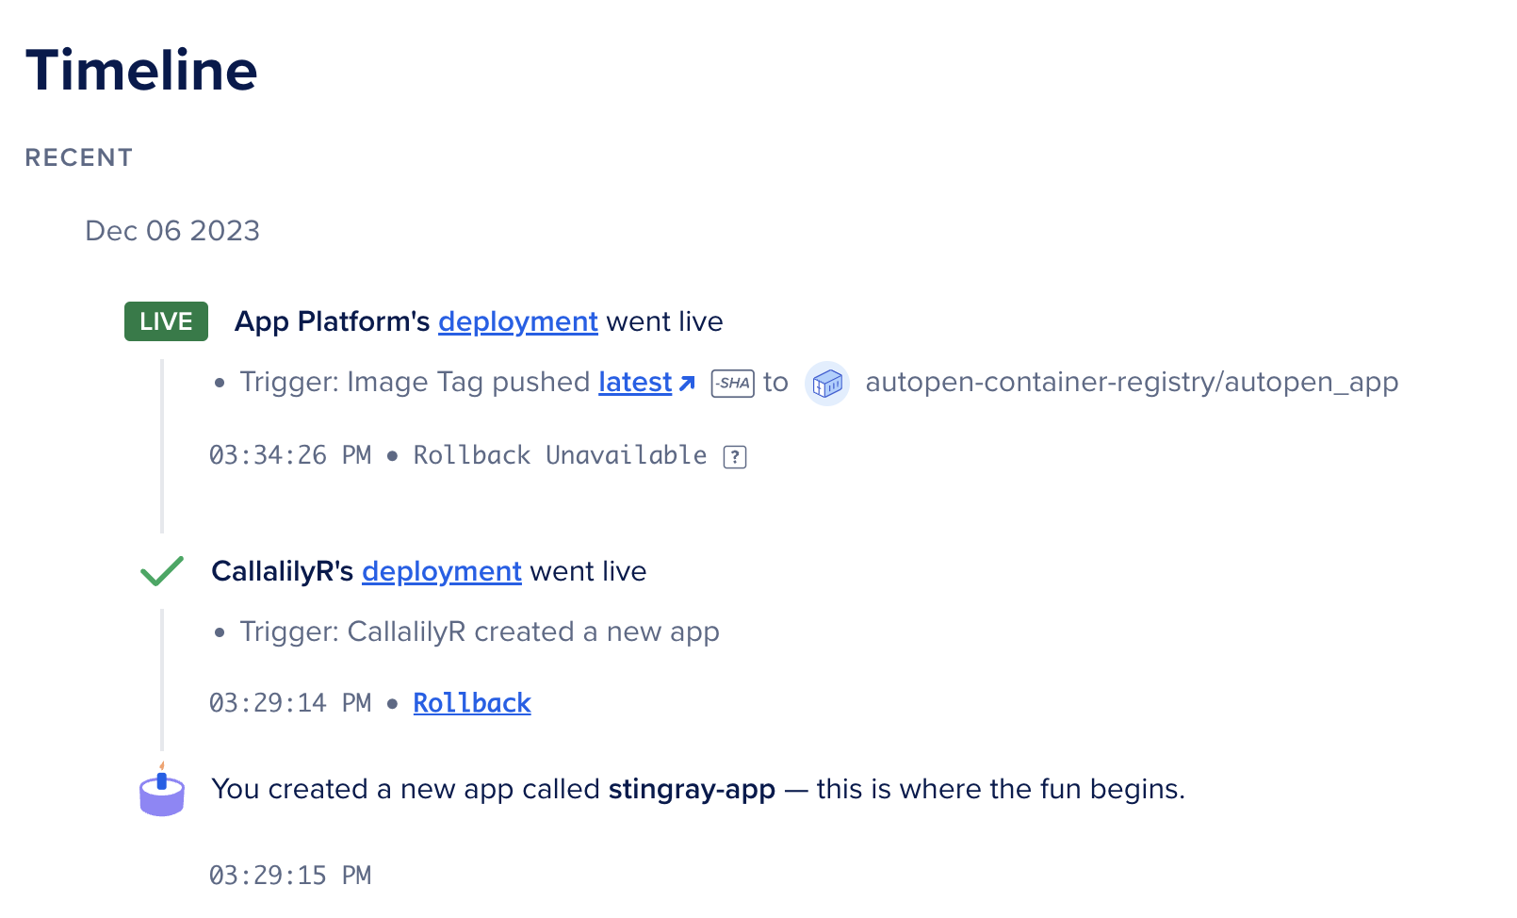
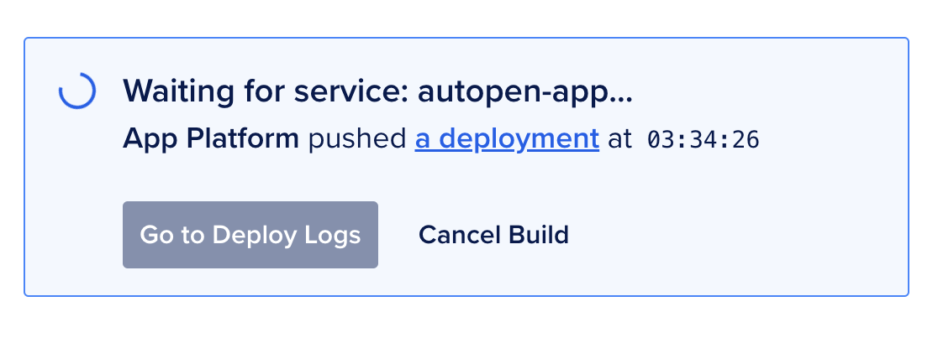

Deployment

Slide 14
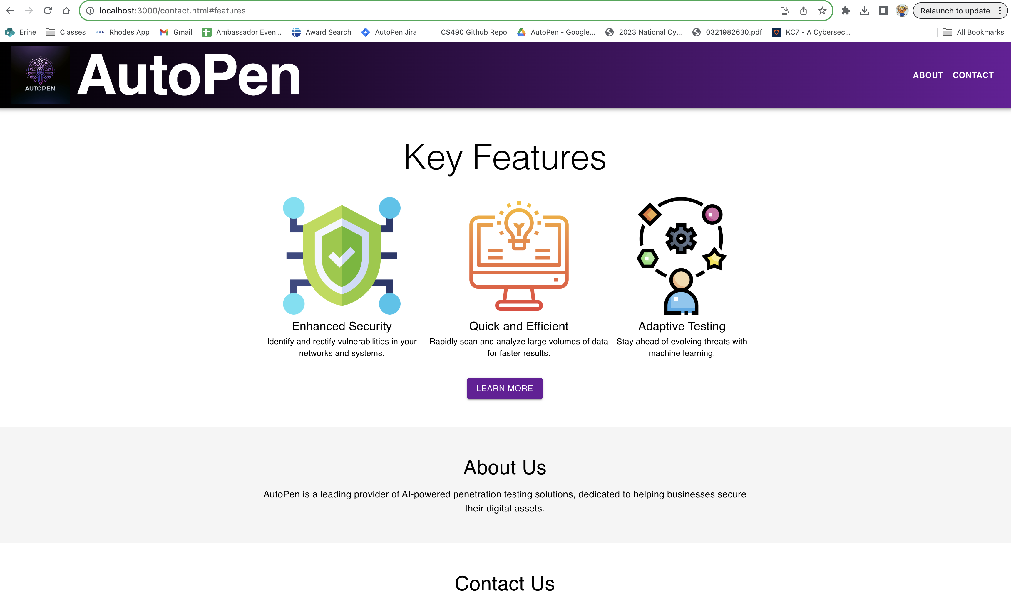
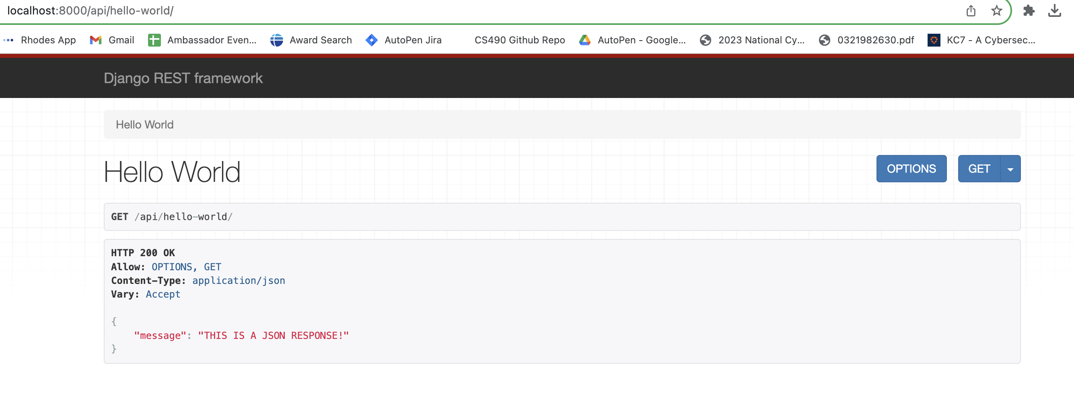

Slide 15
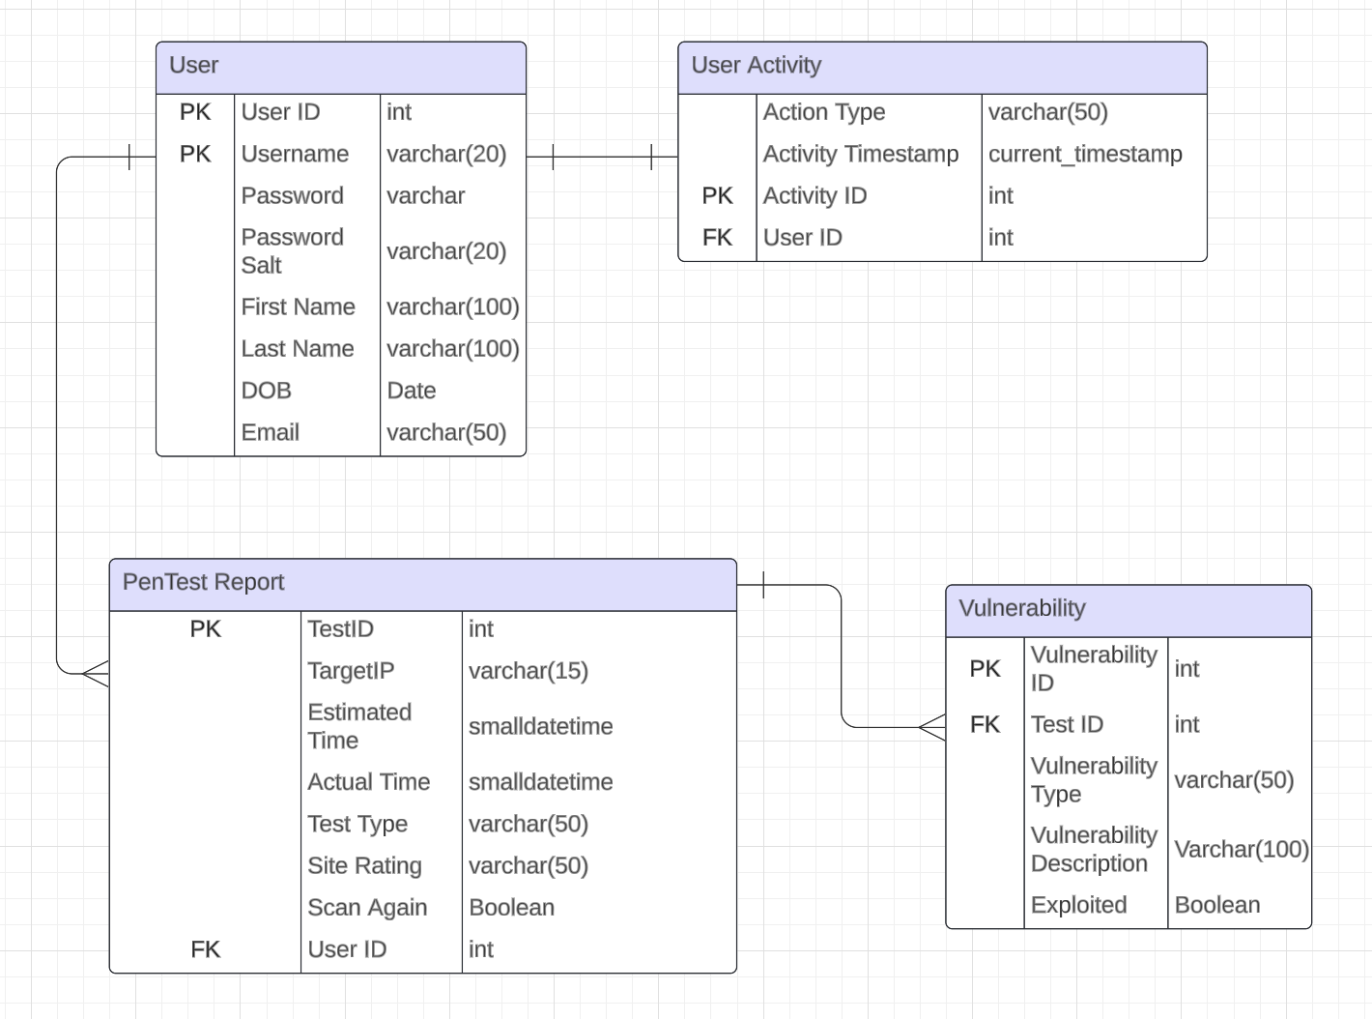
Database Schema

Slide 16
AutoPen Demo

Slide 17
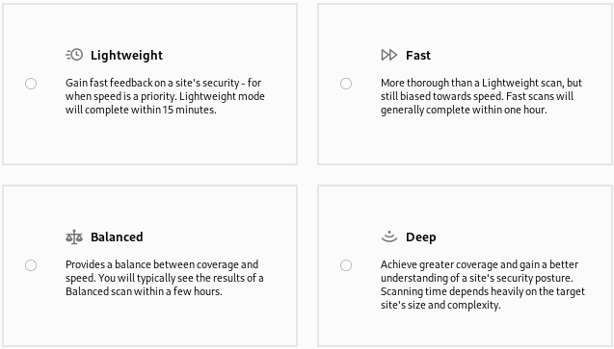
Scan Options

Slide 18
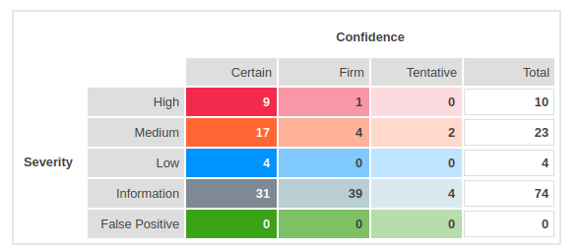
Executive Summary

Slide 19
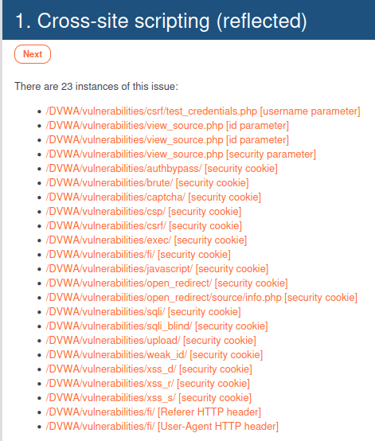
Discovery List

Slide 20
Technical Explanation
Background
Remediation
Details on what the vulnerability is
Impact of vulnerability
Provides information on how to fix vulnerability

Slide 21
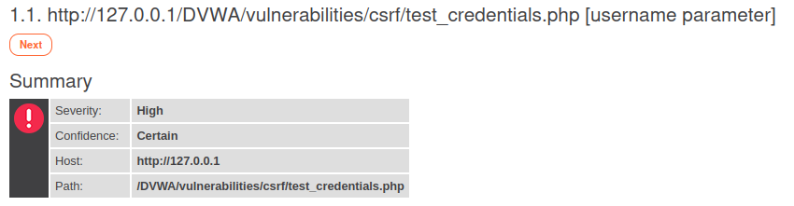
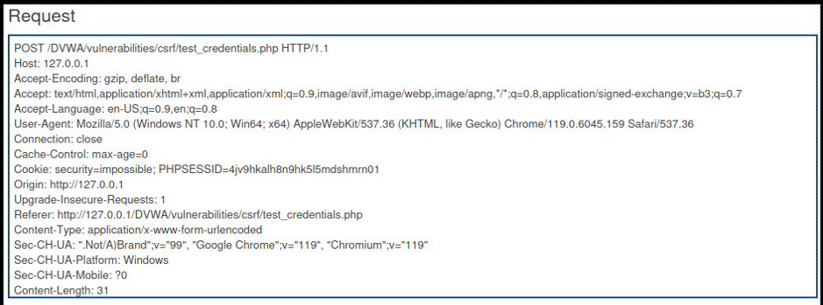
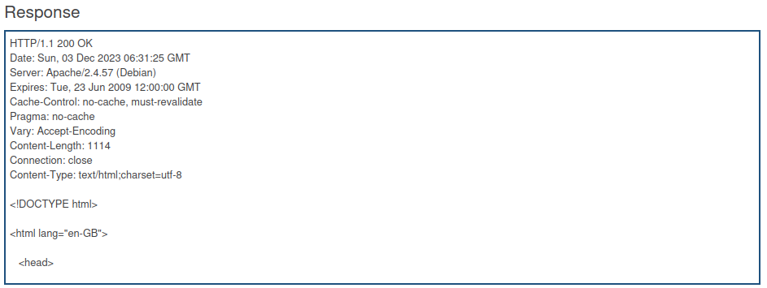
Detailed Findings

Slide 22
Limitations & Challenges
Current Limitations:
Time Constraints
Skill Limitations
Financial Constraints
Challenges:
Legal and Ethical Considerations
Technology Integration

Slide 23
Lessons Learned
Web Development Skeleton
Create skeleton sooner
Test skeleton locally before deploying
Ask professionals
Scrum
Monolithic tasks
Need to break tasks down better

Slide 24
Future Goals
Smarter AI
Cleaner Cloud
Custom Scan Code
Transition from static to dynamic learning models
Improved integration of back-end algorithms to front-end web service
Expand past the pre-built Burpsuite tools

Slide 25

Questions & Answers

